Slide 1
USER
Requirement
Analysis
IBM Block Chain based on Consumption credit points exchange system

Slide 2
PART
1
Functional Requirement
This part will show the functional architecture about the user function and I will explain several significant functions.

Slide 3
Function Architecture
1
User
Account
Module
Support
Module
Transfer
Module
Registor
Login
Logout
View
Points
View
Rate
Add
Seller
Exchange
Request
View
Order
choose from
recommended
list
Account Module: functions for user check in&out
Support Module: support functions for the main function
Transfer Points Module: functions related to points-exchanging

Slide 4
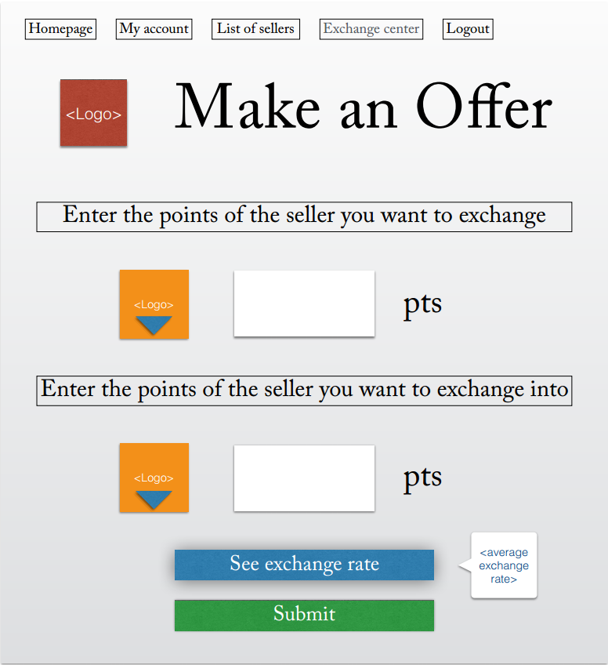
View Rate
If users want to check the latest points exchanging rate of company A and company B, they will get the result via this function.
Add Seller
Users have to get the company A into their membership list so that they can exchange their credit points in company A.
Exchange Request
Users need to fill in the table about the company that they want to exchange points and the rate they expect.
Users will get a recommendation list with 5 recommendations when they have submitted the exchange request, and they need to choose one from the list.
Choose from Recommended List
Exchange Request Template

Slide 5
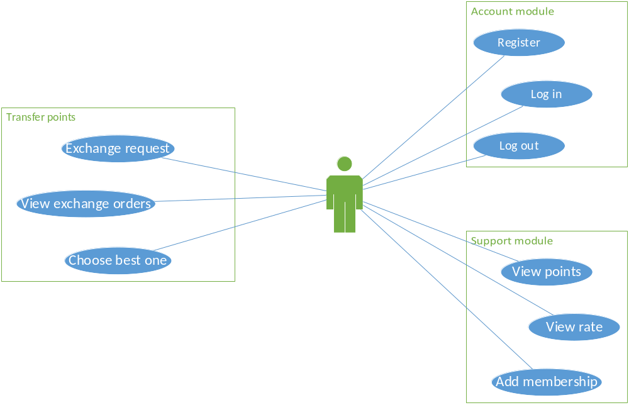
Use Case Diagram
user

Slide 6
PART
2
Interfaces from other groups
This part will introduces interfaces that we need from the other groups.

Slide 7
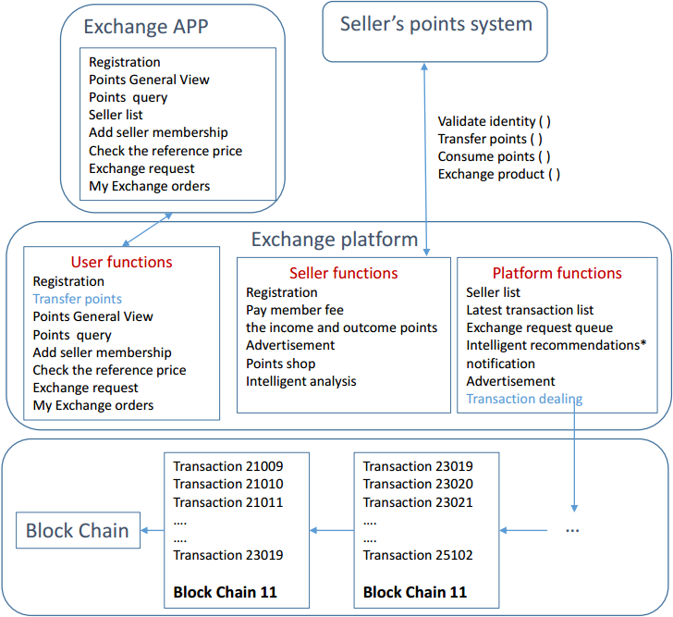
Interface Needed
After users filling the table about the dealing data, we need the platform group to provide a interface to deal the transaction and then return 5 recommendation order.
Exchange Points
Reccomendation Confirm
And users should choose one order from the recommendation list, and we will send it to the platform.
Points in
Seller
When users check the latest rate between two seller's, we need to check some related sell's information.
When users add the seller membership, the platform need send us the list of seller's name , and we will return the user's choice.
Seller List
Front-End Interface
...
Transfer Points
...

Slide 8
PART
3
Non-Functional Requirement
We discuss a few non-functional requirement the user function of the system need to provide.

Slide 9

Performance
Thousands users online at the same time
Non-Functional Requirement
Exception
Most normal exceptions in transaction procedure can be handled
Security
Prevent common threats such as SQL injection and XSS attacks
Interface
Application interface with documents provided
Except user interface(provided by mobile group)

Slide 10
PART
4
Bussiness Process Diagram
This part will be introduced by Mr.Gong, and he will talk about the process of the whole exchange procedure.

Slide 11
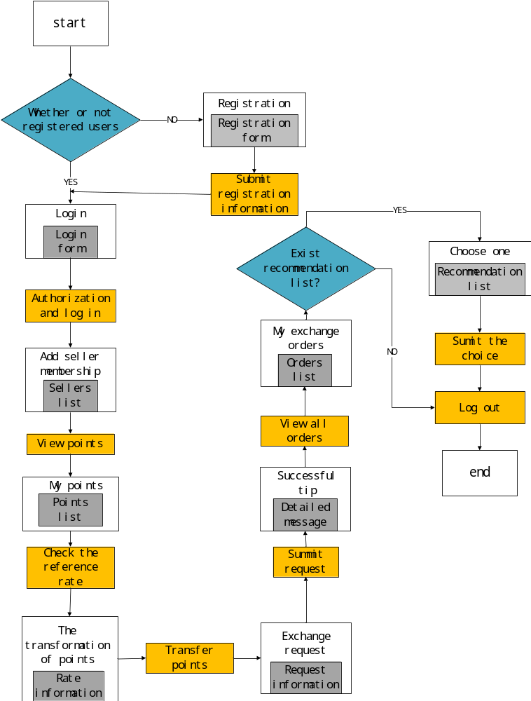
4
BussinessProcess Diagram

Slide 12
THANK
YOU!

